Slide 1
Front End Engineering-2 Project
Team Details:
2210990401 Himani
2210990403 Himanshi
2210990398 Heena
Chitkara University Institute of Engineering and Technology,
Chitkara University, Punjab

Slide 2
Table of Contents
Introduction
Technical Details
Key Features
Results
Conclusion

Slide 3
Group members
Facebook
Himani-2210990401(G-30)
Himanshi-2210990403(G-30)
Heena-2210990398(G-30)

Slide 4
Introduction
The proposed design/methodology for the social media dashboard involves a main page which displays posts and they have been made dynamic with the use of javascript, moreover we also included a profile page and stories which flaunt javascript used. These have been made using HTML, CSS and JavaScript. HTML forms the structural backbone, defining the content and layout of the application. CSS is employed for styling, ensuring a visually appealing and user-friendly interface. JavaScript, being a versatile scripting language, introduces dynamic elements and interactivity, enhancing the overall functionality.

Slide 5
Key Features
Homepage:
We have created the structure of the main page which includes the navigation bar , left sidebar, right-sidebar and the main content. The main content includes posts which with the use of api generates random images and text , the posts with the use of javascript perform functions like liking the posts or sharing it. The left sidebar includes icons and text which on clicking can take us to the desired page. Although the right side-bar ,includes chats, events and advertisements , are not functional , we will try to make all of them functional in the further development of our project.
Profile page:
This page includes profile picture of the account holder, personal information of the user , people connected and suggestions of people the user may know.

Slide 6
Top of the main page:
On the top of the main content we have included stories of the people which with the use of javascript have been made functional and on clicking shows peoples’ photos and videos. It also includes a card which takes input from the user with the placeholder named “what’s on your mind”
Navbar:
The navbar includes a search bar , icons of( homepage, groups to explore , people you may know). These icons on clicking take us to the respective pages. The navbar also includes some icons and settings-menu . The settings-menu contains different functions including a toggle button for dark mode which the user can use it accordingly.

Slide 7
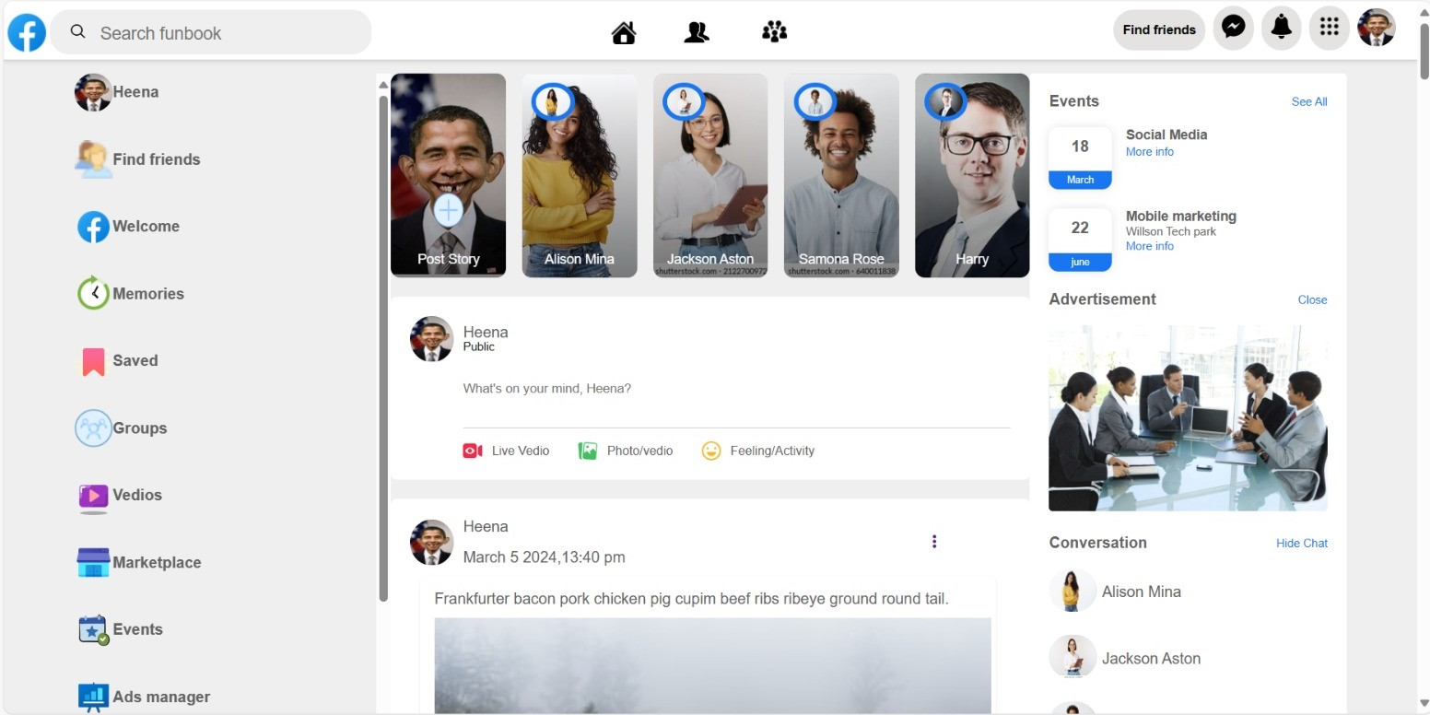
Front page
Results

Slide 8
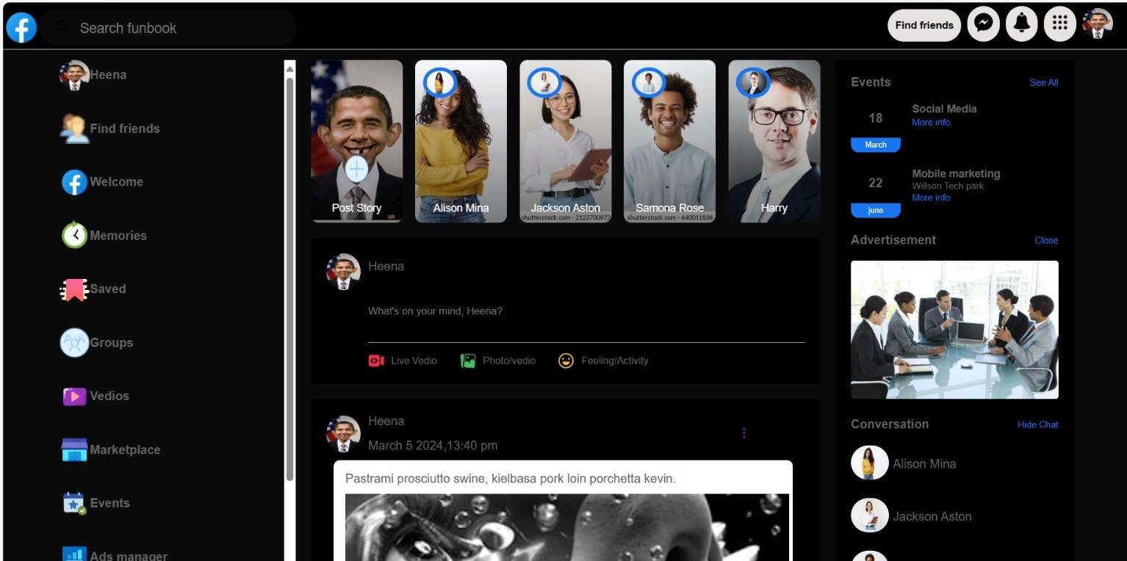
Dark mode

Slide 9
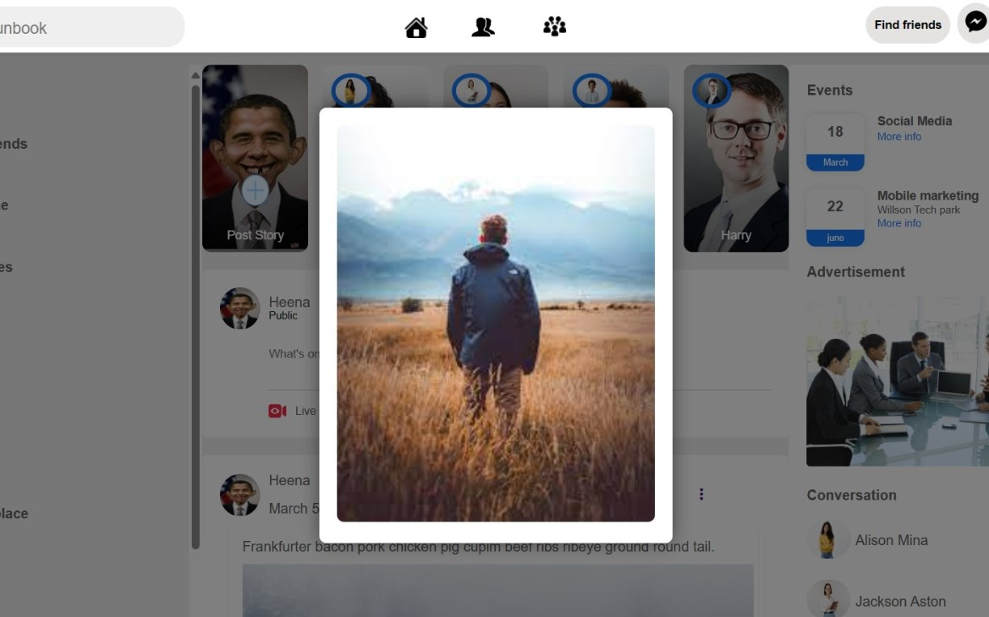
story

Slide 10
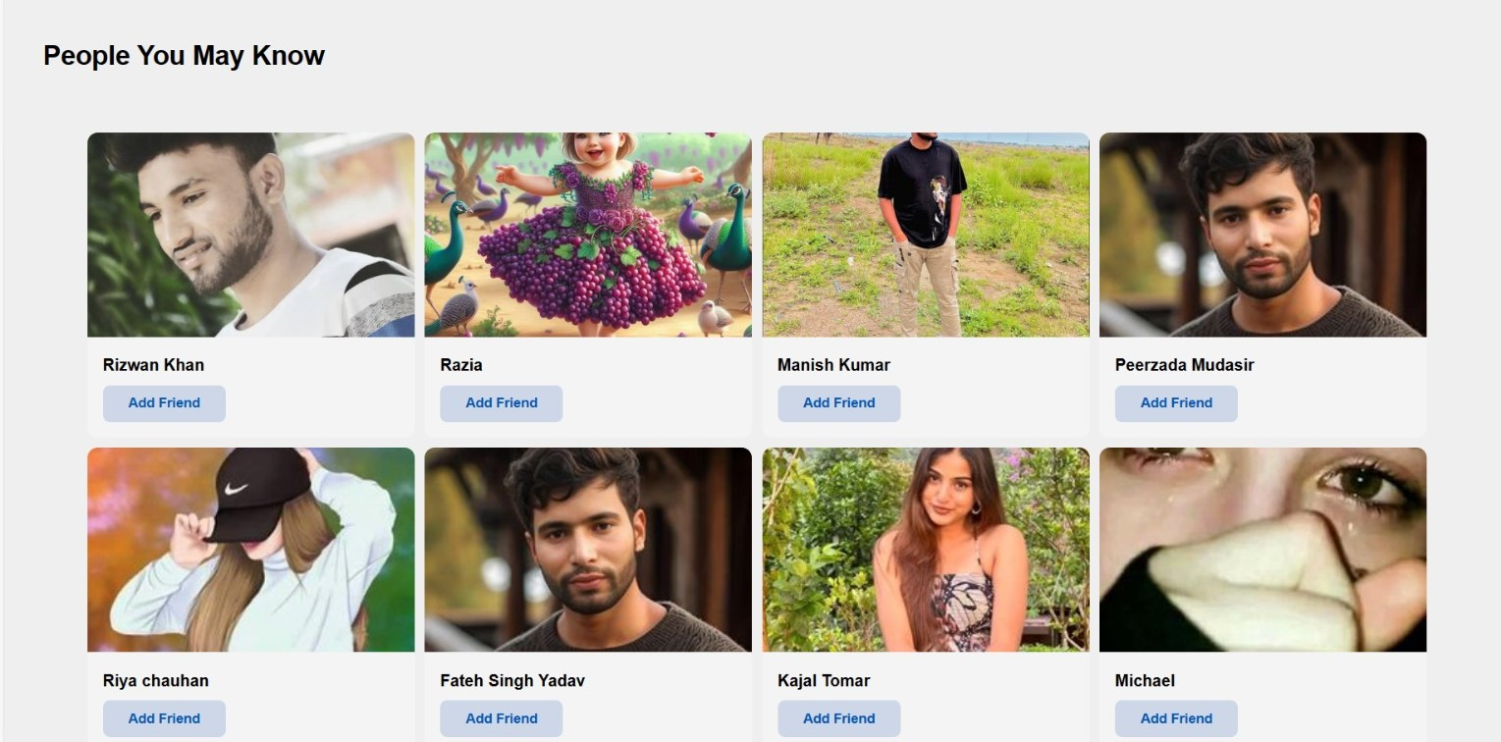
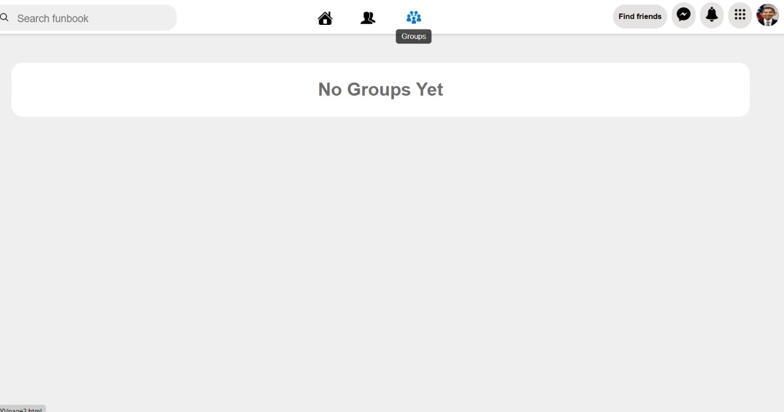
Other tabs

Slide 11
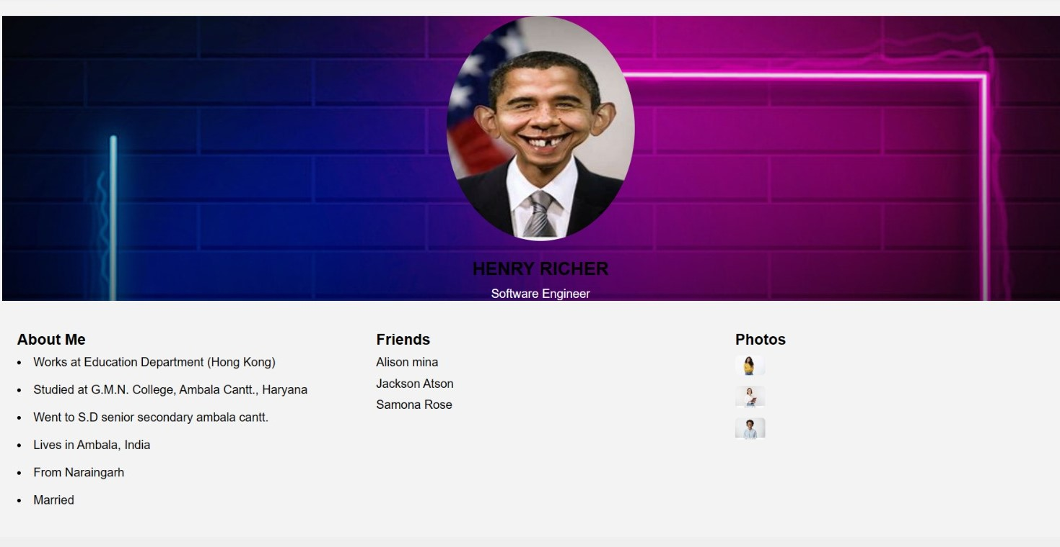
Profile page

Slide 12
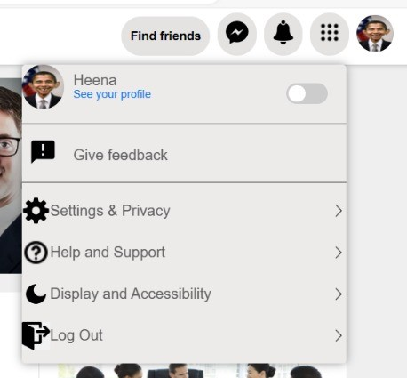
Settings menu

Slide 13
Conclusion
This site is a fun way of exploring world while sitting on home only . We can see different peoples’ posts , like the posts which include our interests , share them to our near and dears and make friends. The site also toggles to dark and light mode which the user can modify according to their needs. So delve into the fun of world using our site “FunBook”

Slide 14


